Slide 1
24
7
30
Date
Topic: Equation of a circle
EQ: What is the equation of a circle?
5

Slide 2
Definition
A circle may be defined as the set of all points, P, in a plane at a given distance from a fixed point in the plane. The fixed point is the centre of the circle and the fixed distance is the radius.
The standard circle has center at the origin, (0, 0) and radius, r. Its equation is of the form
x² + y² = r²
y
r
(0,0)
x

Slide 3
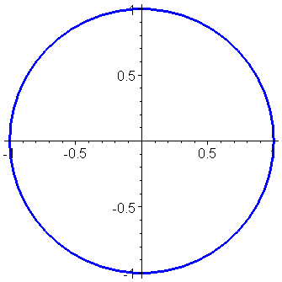
Unit Circle equation
where the center of the circle is at the origin (0,0) and with a radius of 1, is called the unit circle.
Since the radius = 1, use the center (0,0) as a reference point and then move 1 point to the left, right, up and down.

Slide 4
MAPPING RULES
We often use a coordinate grid when we work with transformations. We use a mapping rule to describe how points and their images are related.
A mapping rule tells you what to do to the coordinates of any point on the figure to determine the coordinates of its image.
Example of Mapping rule:
(x, y) (5x, 5y)
It tells you to multiply the x-coordinate by 5 and multiply the y-coordinate by 5.

Slide 5

Question 1:
The equation of a circle is $x^{2}+ y^{2}=36.$
a) What is the centre?
b) What is the radius?
c) Does the point P(4, 4) lie on the circle? If not, where is the point in relation to the circle? Justify your answer mathematically.

Slide 6

Question 2:
The equation of a circle is $x^{2}+ y^{2}=25.$
a) What is the centre?
b) What is the radius?
c) Does the point P(3, 4) lie on the circle? If not, where is the point in relation to the circle? Justify your answer mathematically.

Slide 7
Question 3:
Write the equation of a circle if the centre is C(0, 0) and A(6, -3) is a point on the circle. Justify you’re answer mathematically.
Write the equation of a circle if the centre is C(0, 0) and A(5, 12) is a point on the circle. Justify you’re answer mathematically.
Question 4:

Slide 8
MAPPING RULES
We often use a coordinate grid when we work with transformations. We use a mapping rule to describe how points and their images are related.
A mapping rule tells you what to do to the coordinates of any point on the figure to determine the coordinates of its image.
Example of Mapping rule:
(x, y) (x + 5, y - 2)
It tells you to add 5 to the x-coordinate and to subtract 2 from the y-coordinate.

Slide 9
Definition
A circle may be defined as the set of all points, P, in a plane at a given distance from a fixed point in the plane. The fixed point is the centre of the circle and the fixed distance is the radius.
The standard circle has center at the origin, (0, 0) and radius, r. Its equation is of the form
x² + y² = r²
y
r
(0,0)
x
y
The general circle has center at (h, k) and radius, r.
Its equation is of the form
(x – h)² + (y – k)² = r²
r
(h,k)
x

Slide 10
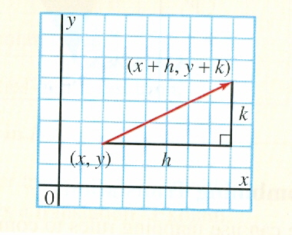
MAPPING RULES FOR TRANSLATIONS
The transformation (x,y) (x + h, y + k) represents a translation for all values of h and k.
YOU NEED TO MEMORIZE THE MAPPING RULES!!!!

Slide 11
Standard form of an equation of a circle
where (h,k) is the center of the circle and r is the radius

Slide 12
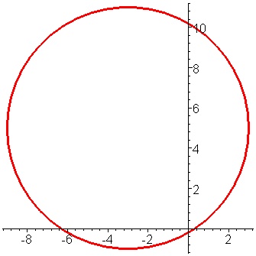
Graphing a Circle
Given the following equation
Recall the standard form of an equation of a circle
Therefore, h=-3, k=5, and r=6.
The center of the circle (-3,5 )
with a radius of 6.
Since the radius = 6, use the center (-3,5) as a reference point and then move 6 points to left, right, up and down.

Slide 13
Graph

Slide 14
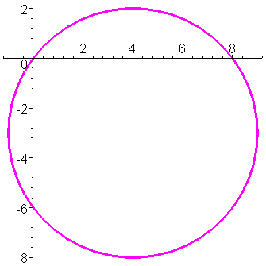
Recall the standard form of an equation of a circle
Find the center (4,-3)
Find the radius 5
Then graph
Since the radius = 5, use the center (4,-3) as a reference point and then move 5 points to left, right, up and down.

Slide 15
Graph

Slide 16
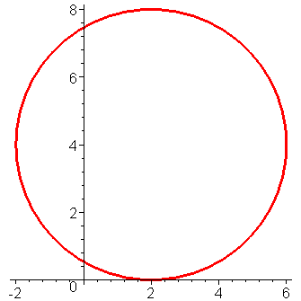
Center (2,4)
Radius 4
Since the radius = 4, use the center (2,4) as a reference point and then move 4 points to left, right, up and down.

Slide 17
Graph

Slide 18
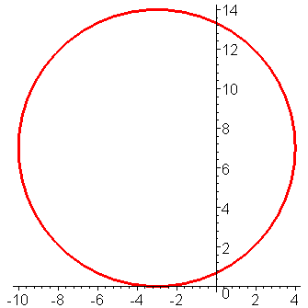
Center (-3,7)
Radius 7
Since the radius = 7, use the center (-3,7) as a reference point and then move 7 points to left, right, up and down.

Slide 19
Graph

Slide 20
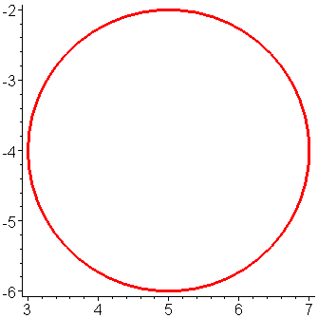
Center (5,-4)
Radius 2
Since the radius = 2, use the center (5,-4) as a reference point and then move 2 points to left, right, up and down.

Slide 21
Graph

Slide 22
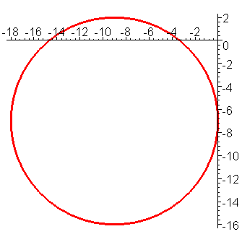
Center (-9,-7)
Radius 9
Since the radius = 9, use the center (-9,-7) as a reference point and then move 9 points to left, right, up and down.

Slide 23
Graph

Slide 24
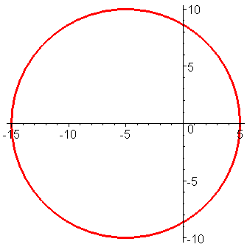
Center (-5,0)
Radius 10
Since the radius = 10, use the center (-5,0) as a reference point and then move 10 points to left, right, up and down.

Slide 25
Congratulations!! You just completed Graphing Circles

